Slide 1

5 Content Hub hidden gems to level up your integration project
Szymon Kuźniak
#sugcon
Notes:
Hi, my name is Szymon Kuźniak and I am a Senior Sitecore Developer at Actum Digital.
My division helps the companies achieve their goals using Sitecore XP, Content Hub and Elastic Search.
I have also been named a Sitecore MVP for the year 2023.

Slide 2
Responsive Images
Choose one image, get as much as you need for free!
Notes:
How you can use Content Hub to get truly responsive images without annoying your content editors.

Slide 3


„Responsive” design
Notes:
By responsive images I don’t mean the usual way of implementing them, where the browser downloads single image, tailored for the biggest screen, and just displays only portion of it.

Slide 4

„Responsive” design
Notes:
While the image is displayed correctly on the phone, we only need about 30% of it, and still the image is downloaded as a whole, and only adjusted in the HTML to show the required part.

Slide 5


Mobile design
Too much data to download
The art direction problem
Notes:
Why this is a problem?
First, we force the user to download unnecessary data.
This might be a problem for users on a metered or poor connection.
But data size is not the only problem - this approach won’t work if the subject of the photo is not in the center.

Slide 6
Responsive image
<picture>
<source media=„WHEN” srcset=„WHAT” />
<source media=„WHEN” srcset=„WHAT” />
…
<img src=„” />
</picture>
Notes:
Well, this is not a new problem, an in fact is long solved.
HTML supports few ways of specifying multiple images, for the browser to choose one.
Here, I have show one of them, it’s neither good or bad, and I choose it mostly because it’s the most intuitive to understand.
The PICTURE tag tells the browser how to interpret the images inside.
Each SOURCE tag contains information WHEN to use an image, by providing expected screen sizes, and WHAT to use, which is the image itself.
Finally, the IMG tag at the bottom is the actual tag which displays the image, so it acts as a fallback, or it can be used to assign a CSS class to it.

Slide 7

What do I have to do to get the images?
FRUSTRATION-O-METER
Notes:
So, what is really our problem?
Let’s quickly see what content editors would have to do in order to configure the component which uses this kind of an image.

Slide 8
What do I have to do to get the images?
Get the original image
FRUSTRATION-O-METER
Notes:
Obviously, they will need an image first, so they go to the place, where all the images are (hopefully it’s only a single place, not more), and select the appropriate image.
Pretty standard.

Slide 9

What do I have to do to get the images?
Get the original image
Crop to the first size
FRUSTRATION-O-METER
Notes:
Now, they need to crop the image.

Slide 10

What do I have to do to get the images?
Get the original image
Crop to the first size
Crop to the second size
FRUSTRATION-O-METER
Notes:
And crop again.

Slide 11

What do I have to do to get the images?
Get the original image
Crop to the first size
Crop to the second size
…
Upload all the images to the CMS
FRUSTRATION-O-METER
Notes:
And keep croping until they get the correct number of images.
How many?
Well, think of 3 or 4 types of the devices, and then different screen dimensions, such as Retina displays, which also adds resizing of the images to the equation.
And once they are done cropping, they need to upload all of this to the CMS.

Slide 12

What do I have to do to get the images?
Get the original image
Crop to the first size
Crop to the second size
…
Upload all the images to the CMS
Match every image with correct screen size
FRUSTRATION-O-METER
Notes:
Now, finally, they must select correct image for correct field, representing each of the SOURCE elements.

Slide 13

The authors:
Notes:
I can imagine what would they think about the CMS, the developers, and their life in general, after spending a day uploading bunch of images where most of them is just a different version of the handful they really needed to use on the page.

Slide 14
The authors:
There must be a better way to solve this…
Notes:
Obviously, I’m exaggerating... a little, but this definitely shouldn’t work like that.
In the CMS, content editors should only select one image and the rest should happen automatically.

Slide 15
DEMO
Notes:
Let’s see how Content Hub can help.
There is a feature hidden at the bottom of the Manage section in Content Hub, called „Transformations”.
It allows to apply globally configured, dynamic renderings to the single public link, effectively allowing developers to transform one public link into multiple images.
Each transformation consits of a name, which is used to reference the transformation (by adding &t=[name] to the query string, dimensions and the crop type.
The crop type is the differentiator here, since the Smart Crop mode gives the CH freedom to select subject of the image and put it in the center of the crop box.
For an example of how it is used, please refer to the ResponsiveImages project in the repository and follow the instructions there.

Slide 16
Get the content…
… without reinventing the wheel.

Slide 17
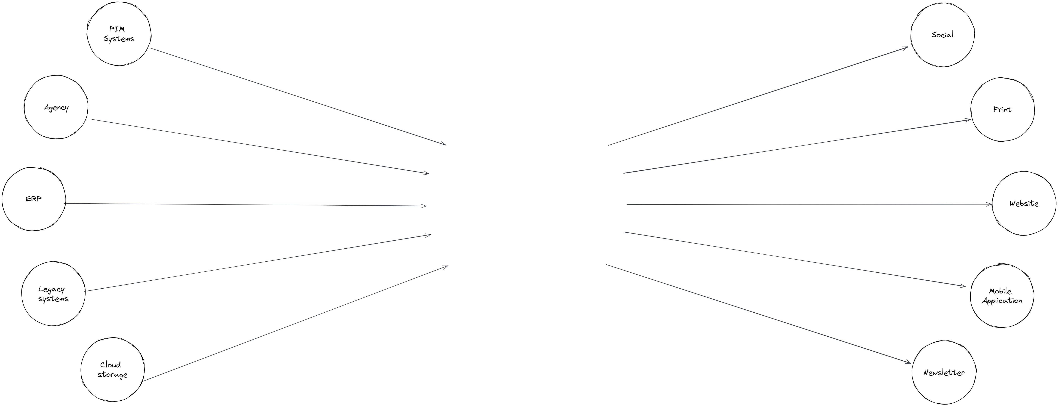

Content Hub
Notes:
I hope you recognize this schema – content crisis and the solution we all know – Sitecore’s Content Hub.
In order to avoid the mess of multiple content sources talking to each other to get the content published on various channels we are using centralized system, which allows to gather, refine and publish content whenever it needs to be published.
Easy.

Slide 18
The easy part
Content Hub
Notes:
Well, the right side is certainly easy.
Each system can frely use Content Hub’s API to synchronize the content, because, originally, it owns the data, and it knows when the data changed and should be send to Content Hub.

Slide 19
The harder part
Content Hub
Notes:
It doesn’t look that good on the other side.
How do the channels know when to get the data?
Should they poll Content Hub every now and then to see if there is anything new?

Slide 20
Don’t call us. We’ll call you.
The Hollywood Principle
Notes:
Obviously not, and this problem is so old, it even got a fancy name „Hollywood Principle”.
If an actor wants a role in a movie, they contact an agent to find them something suitable.
But actors can’t call the agent couple times a day, because the agent will not have time to search for the role, if all they do is responding for actors’ calls.
It’s better if actors patiently wait for the call from the agent.

Slide 21
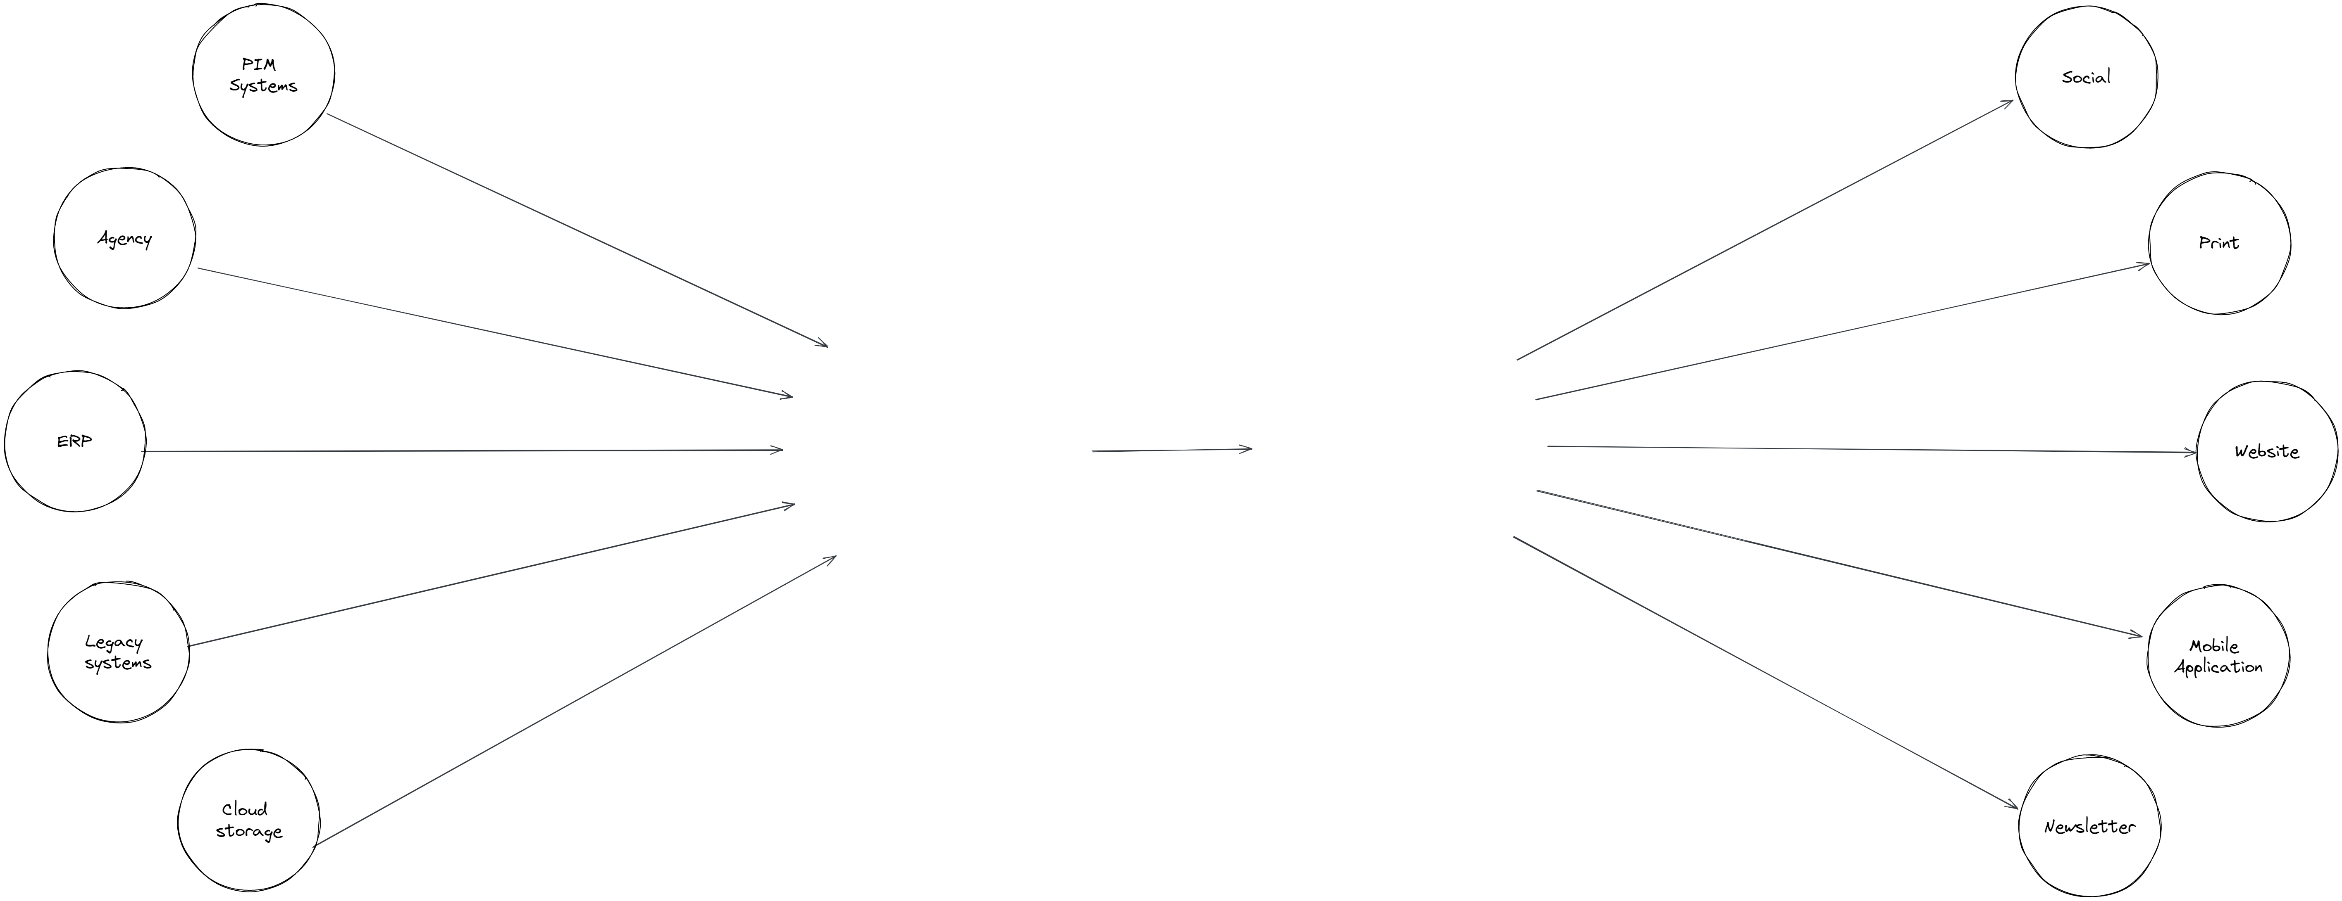
?
Content Hub
Notes:
In our case, various channels are actors and content hub is an agent.
But how will they communicate?

Slide 22
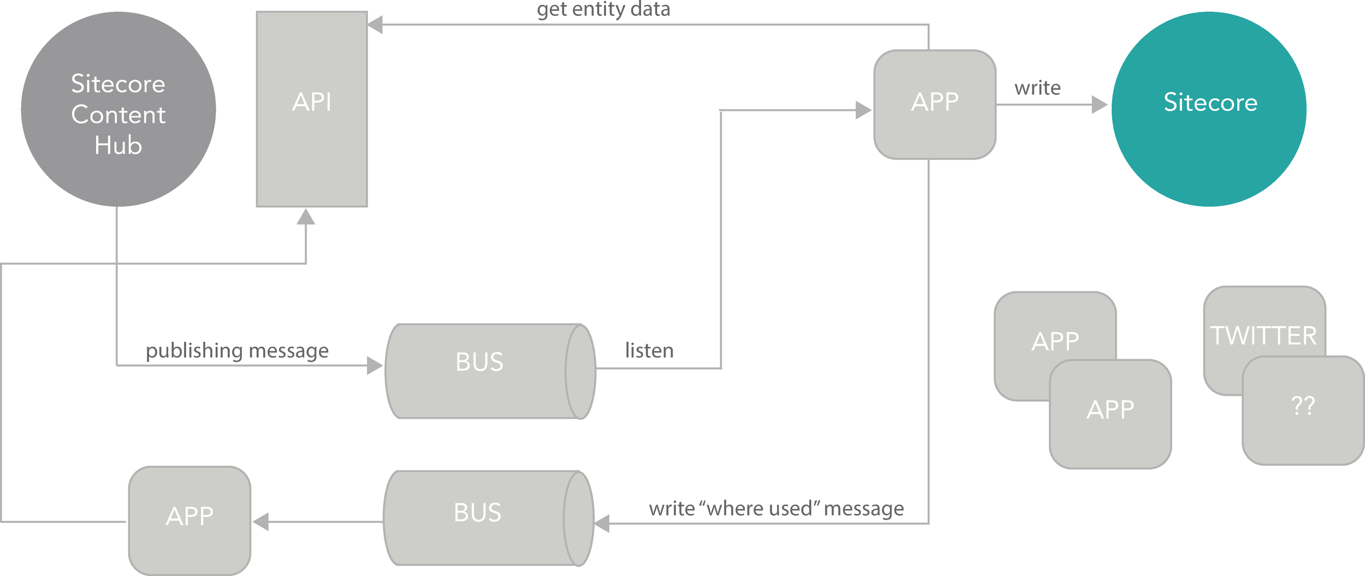
Don’t reinvent the wheel
Notes:
I really like the way Sitecore Connector is implemented.
Sitecore Connector uses Azure Service Bus, which is natively supported by Content Hub to get notifications about changed content.
Such notification is a lightweight message with the entity ID which has been changed.
When the connector know there is changed content it can synchronize, it will then use the API to get all the data it needs from the changed entity.

Slide 23

Content Hub
Azure Service Bus
Notes:
However, there might be mutlitple channels and regular one to one communication will soon become problematic.
Fortunately Azure Service Bus has a solution, which is of course already adapted by Sitecore Connector.
It’s called Topics.

Slide 24
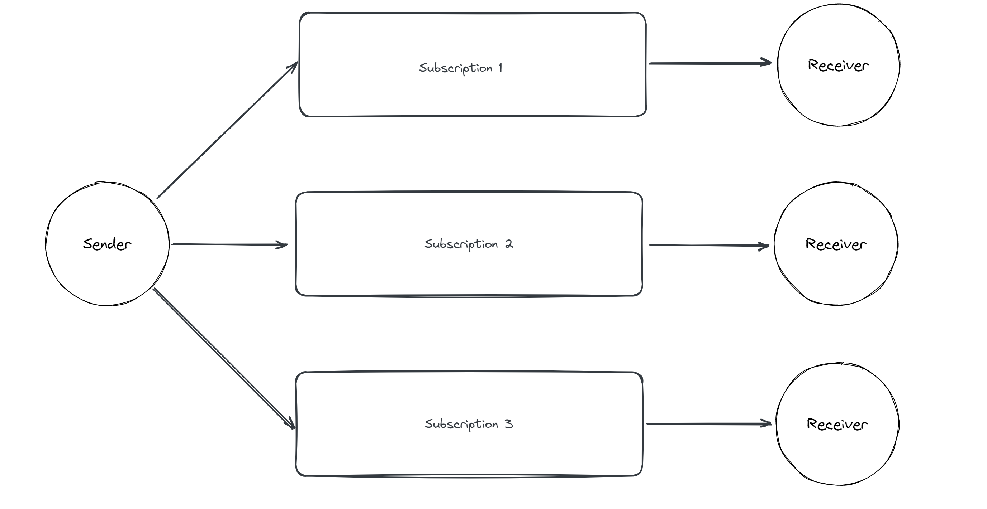
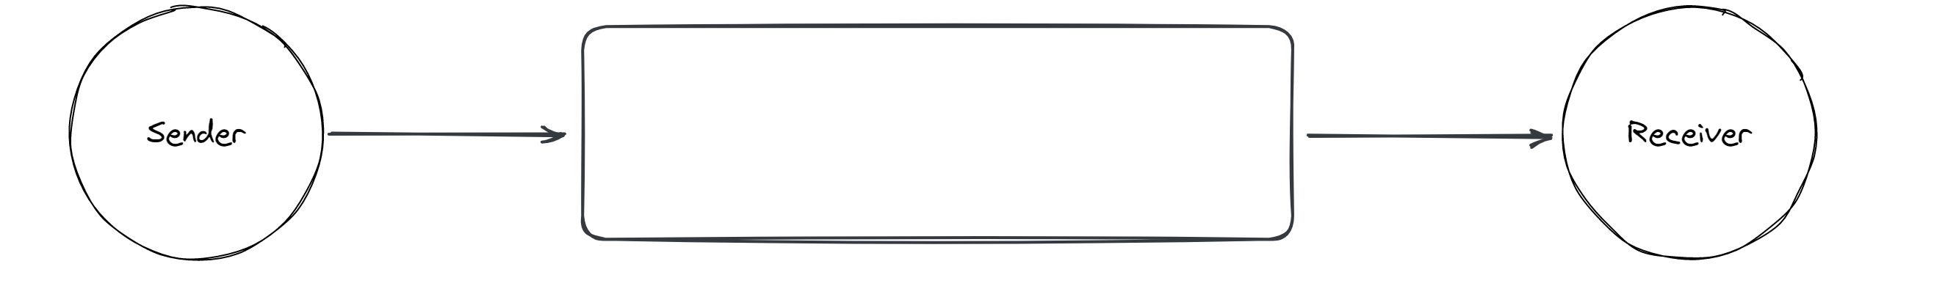
Azure Service Bus
Queue
Topic
Notes:
The topis are pretty much queues on steroids.
Queue supports one to one communication, where one sender can only communicate with one receiver (and if there are more than one receiver, they will compete for the message).
Topics suport one to many communication with multiple subscriptions, allowing more than one receiver to get the message.

Slide 25
DEMO
Notes:
The demo assumes there is a working connection between Content Hub and Sitecore XP instance.
For more details on this see blog post: https://skuzniak.github.io/2022/10/24/connect-content-hub-with-sitecore
In this case, in order to introduce another client, all that has to be done is to create another subscription and get the topic connection string and subsription name.
Those can be used in the ContentHubConsumer project to create a client listening on the new messages from Content Hub.
And this is done without setting up anyting on the Content Hub side.

Slide 26
Don’t miss out anything
Just extend what you need

Slide 27

Sitecore CMP Connector
Things you can synchronize
Content fields
Content relations
Things you can’t synchronize
Products
Content attachments
Notes:
Sitecore CMP connector offers to synchronize basic elements of the Content module, such as content fields or relations.
In theory it is possible to synchronize also other entites, such as Products, but there is major problem – the connector supports only single language properties.
With Products having many of their default fields multilingual, it renders this option as useless.
It’s also impossible to synchronize content attachments, most probably because of technical difficulties.

Slide 28
Sitecore CMP Connector
Pipeline
Templates
Dedicated processor
Notes:
However it’s worth pointing out that Sitecore CMP Connector uses pipeline and a dedicated processor.
This means, it can be easily extended with custom one.

Slide 29

What to do
Create custom templates
Override the default processor
Synchronize all the things
Notes:
The plan to extend the connector is simple:
Adding new templates will let me decide wether to use my custom processor or

Slide 30
DEMO
Notes:
The demo assumes there is a working connection between Content Hub and Sitecore XP instance.
For a detailed instruction see: https://skuzniak.github.io/2022/12/29/synchronizing-multilanguage-fields
The code is also available in the ExtendCmpConnector project.

Slide 31
Let’s talk about security
ALL for one! But sometimes just ANY will do…
Notes:
When I first read about CH security model, I was quite confused about how it works, and my first attempts to configure reliable user rights were not something I’m proud of...

Slide 32


Content Hub security challenges.
Denying access
Inheritance of access
Notes:
What are the biggest challenges?
In Content Hub you can only grant access, which means once you grant the access, it cannot be revoked.
There’s also no inheritance of the user groups.

Slide 33
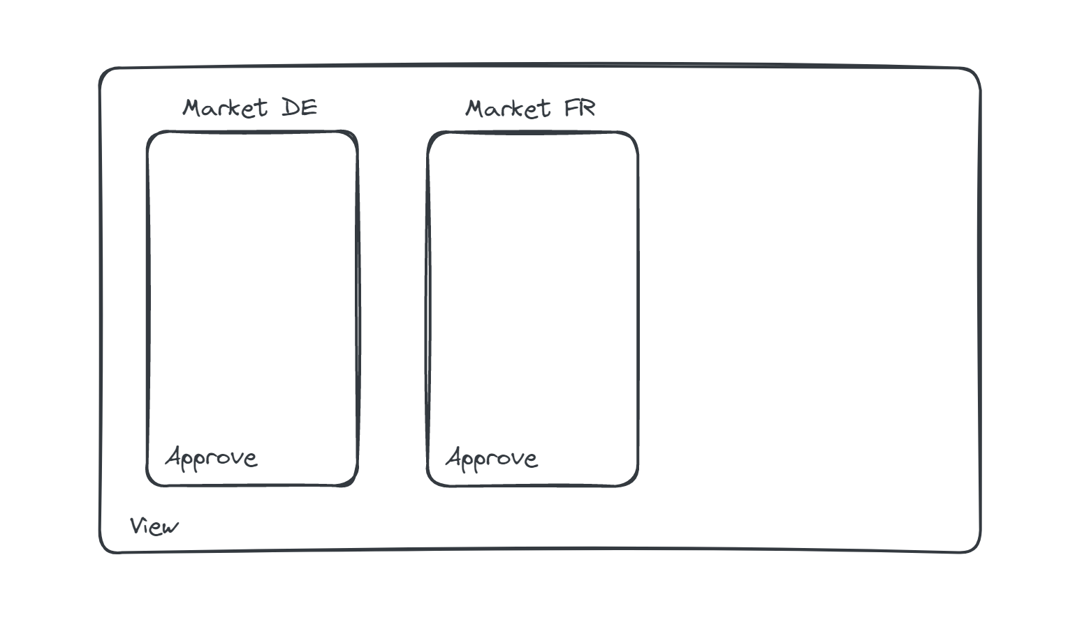


What’s the problem
Notes:
Because of that restrictions, setting up access right for two reviewers, each for different market or division might become problematic.
Obiously, we want to have users with view access to everything.
Approvers, should also have this level of access to all the entities.
But only local approvers can have approve access to their makret.

Slide 34

DE Reviewer
FR Reviewer
General Access
Read access to portal pages
Basic access to Entities
Specialized Access
Approve access to Lifecycle parts
Approve access to DE market
Specialized Access
Approve access to Lifecycle parts
Approve access to FR market
Notes:
The first approach would be to create one policy with general read access for everyone.
Then create separate local groups for each approver.
It’s ok, but those local groups will have a lot in common and will only differ in one detail – the market.
This quickly becomes a problem when it comes to maintaining those groups.
And mind, that here we just have two groups, while in real life ther can be way more.

Slide 35
DE Reviewer
FR Reviewer
General Access
Read access to portal pages
Basic access to Entities
Specialized Access
Approve access to Lifecycle parts
Local Access
Approve access to DE market
Local Access
Approve access to FR market
Notes:
Ideally, we would like to extract common part, into a separate group and just have tiny, specialized local groups.
But how can we do this in Content Hub, if by default if any of the policies grants access, then the access is granted?
There’s no way of denying the access.

Slide 36
DE Reviewer
FR Reviewer
General Access
Read access to portal pages
Basic access to Entities
ANY
Specialized Access
Approve access to Lifecycle parts
Local Access
Approve access to DE market
Local Access
Approve access to FR market
Notes:
Let’s see how this works in practice:
If we use ANY combination, then all the users with Specialized Access group will have approver access to all the markets.
That’s because it gives approve access and the Local Access policy will be ignored

Slide 37
DE Reviewer
FR Reviewer
General Access
Read access to portal pages
Basic access to Entities
ALL
Specialized Access
Approve access to Lifecycle parts
Local Access
Approve access to DE market
Local Access
Approve access to FR market
Notes:
If we use ALL combination, then the users will not have Read access to others

Slide 38
DE Reviewer
FR Reviewer
General Access
Read access to portal pages
Basic access to Entities
ANY
Specialized Access
Approve access to Lifecycle parts
ALL
Local Access
Approve access to DE market
Local Access
Approve access to FR market
Notes:
The solution is to use both of the poilicy combinations.
ANY – for the top level policies.
ALL – for a set of the policies that contain access rights to the concrete market

Slide 39
DEMO
Notes:
For a detailed description with screenshots see blog post: https://skuzniak.github.io/2023/03/30/content-hub-security

Slide 40
Any vs. All
IF ANY of the policies grants access THEN the access is granted.
IF ALL of the policies combined grant access THEN the access is granted.
Notes:
The keyword here is ANY.
In Content Hub there are two ways of combining policies:
ANY – means that whenever any of the policies grants access, the access will be granted
And
ALL – which acts as a substitute for the inheritance and joins the policies into one big policy

Slide 41


Slide 42
That’s great, now please create 1000 users
They will start working tomorrow
Notes:
This is all clear now but what if your client would like to onboard entire department the next day?

Slide 43
Content Hub admin:
Notes:
Even if you would spend 1 minute on a single user, creating 1000 user would take you around 16 hours.
Clearly, there must be another way.

Slide 44

Create one user
Export the user to excel
Add other users
Copy policies of the first user
Import users
Profit

Slide 45
Demo

Slide 46
@szymon.kuzniak
@skuzniak

